Slide 1
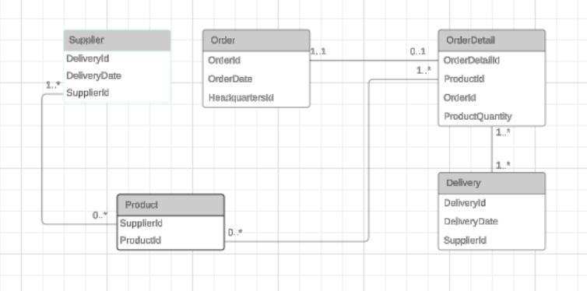
Delivery(DeliveryId, DeliveryDate, SupplierId)
OrderDetail(OrderDetailId, ProductId, OrderId, ProductQuantity)
Product(SupplierId, ProductId)
Supplier(DeliveryId, DeliveryDate, SupplierId)
Order(OrderId, OrderDate, HeadquarterId)
Assign(#OrderId, #DeliveryId)

